Slide 1
DSC 530 Final Project How do Student Activities Affect GPA?
Alyssa Graham

Slide 2
Statistical Question
How is the academic success of a student affected by how they spend their time outside of class?
Hypothesis
If a student spend more time outside of class working on assignments and studying, their academic success (GPA) will be higher than those that spend their time on activities not related to course material.

Slide 3
Variables
Study Hours Per Day
Extracurricular Hours Per Day
Sleep Hours Per Day
Social Hours Per Day
Physical Hours Per Day
GPA

Slide 4
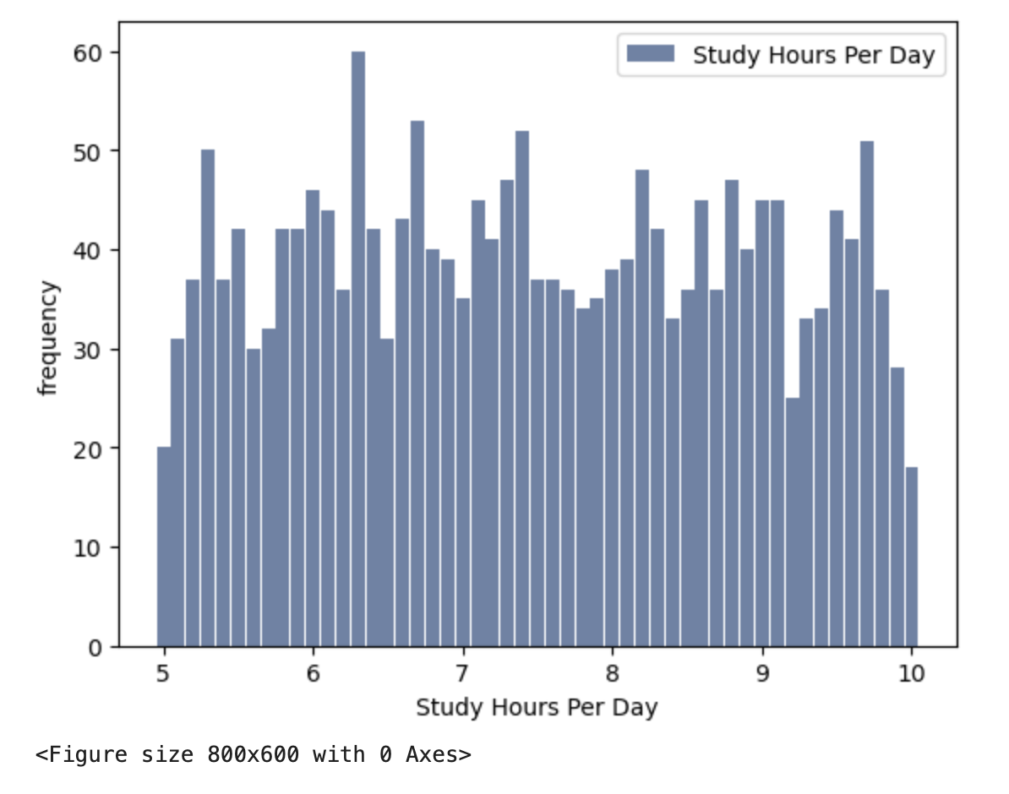
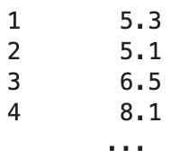
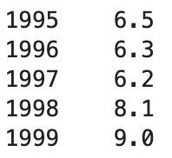
Study Hours Per Day
Average number of hours spent studying, per student, each day
Mean = 7.4758
Mode = 6.3
Variance= 2.0274
SD = 1.4238
Tails =

Slide 5
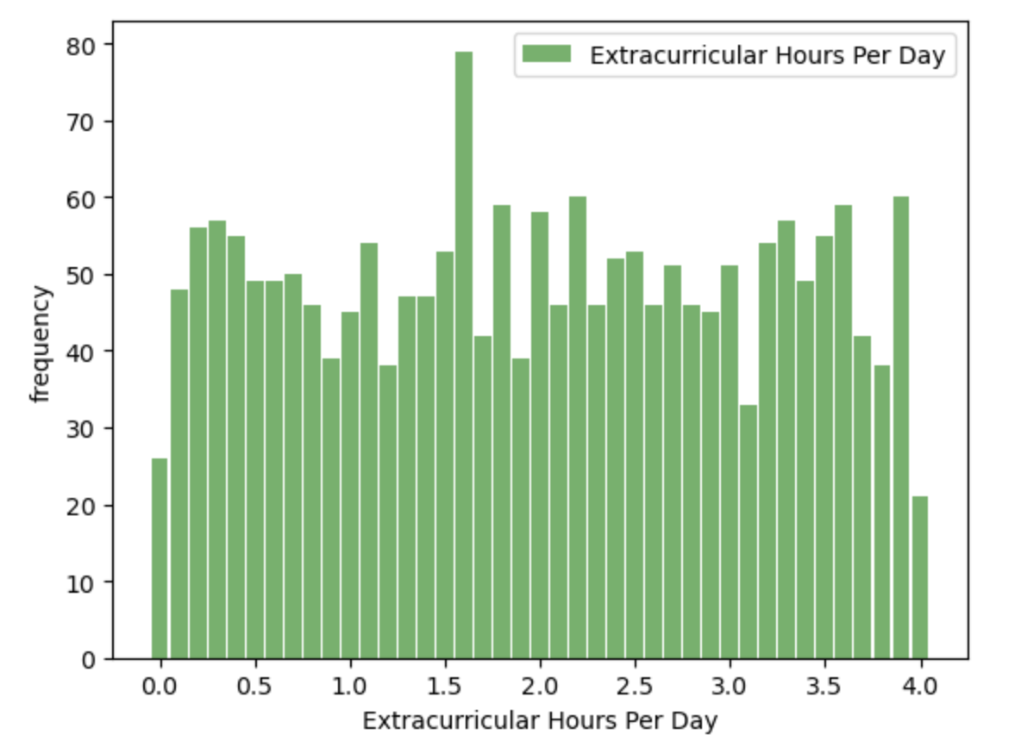
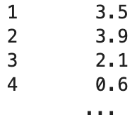
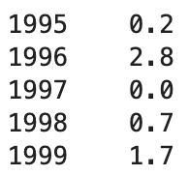
Extracurricular Hours Per Day
Average number of hours spent participating in extracurricular activities, per student, each day
Mean = 1.9901
Mode = 1.6
Variance = 1.336
SD = 1.1559
Tails =

Slide 6
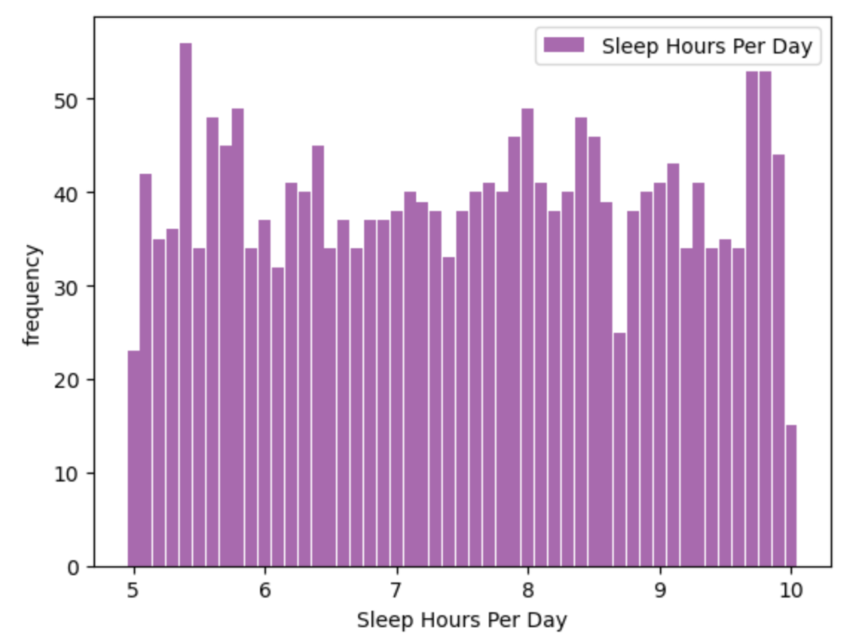
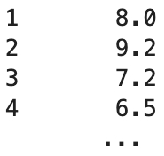
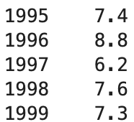
Sleep Hours Per Day
Average number of hours spent sleeping, per student, each day
Mean = 8.0
Mode = 9.2
Variance = 2.1344
SD = 1.4609
Tails =

Slide 7
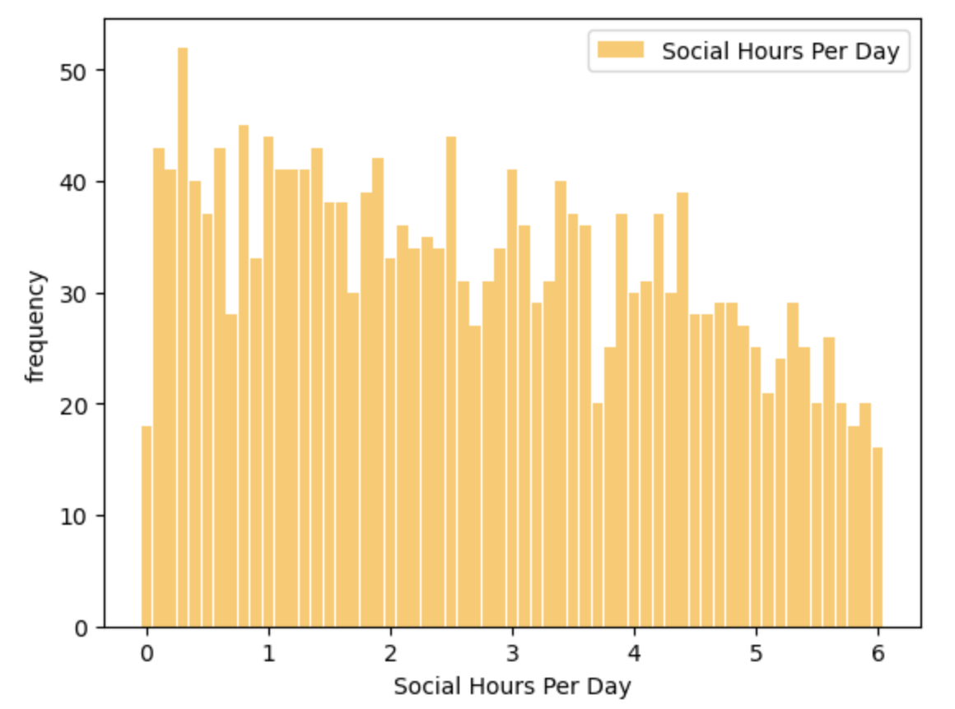
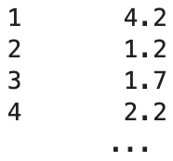
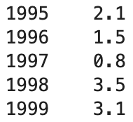
Social Hours Per Day
Average number of hours spent on social activities, per student, each day
Mean = 2.7046
Mode = 0.3
Variance = 2.8512
SD = 1.6885
Tails =

Slide 8
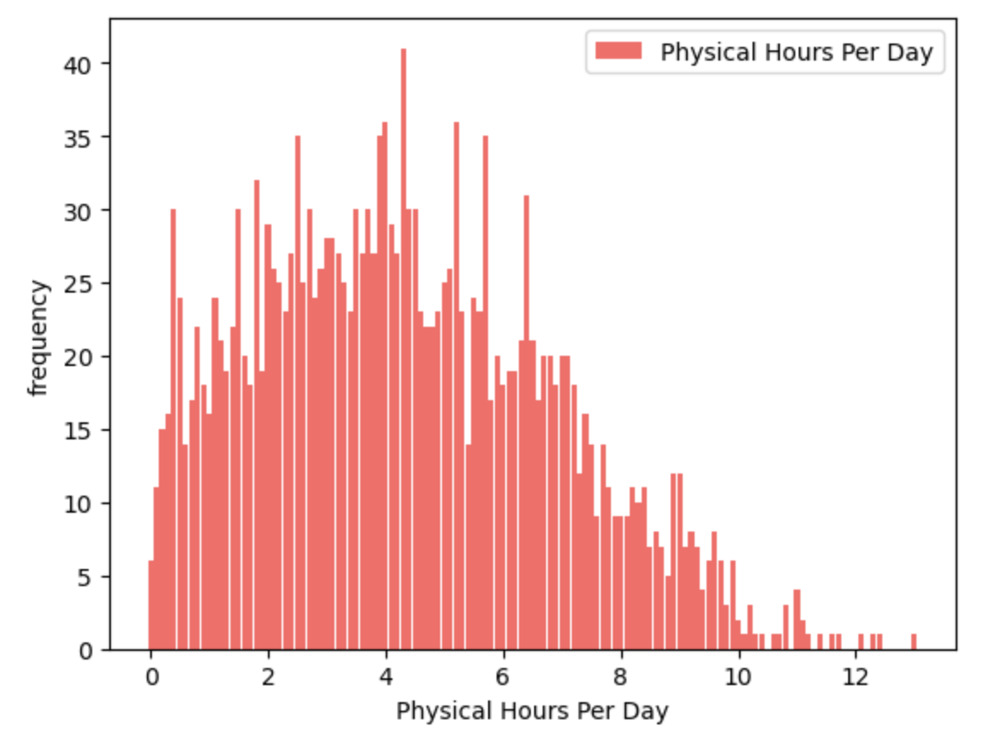
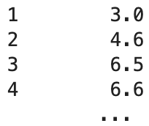
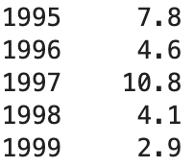
Physical Hours Per Day
Anything over 10 hours a day may be an outlier. These most likely occur because of organized sports. It is unlikely that students would be able to maintain this many hours of physical activity and still attend classes.
Average number of hours spent on physical activity, per student, each day
Mean = 4.328
Mode = 4.3
Variance = 6.3207
SD = 2.5141
Tails =

Slide 9
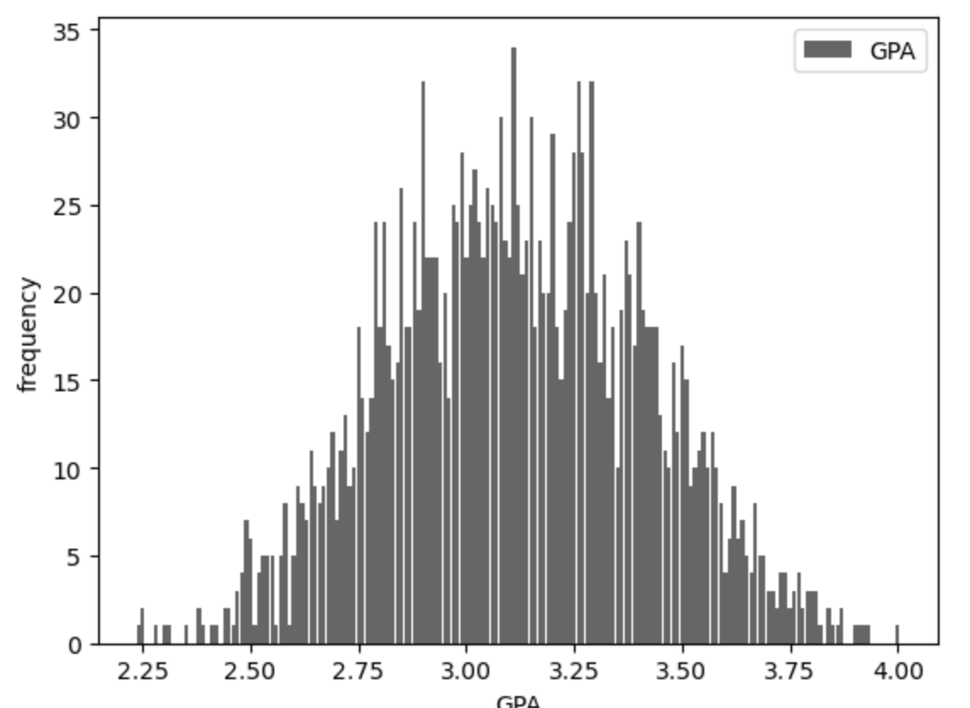
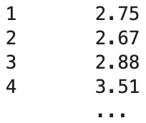
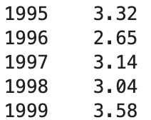
GPA
Summary of each students average score across all courses
Mean = 3.1160
Mode = 3.11
Variance = 0.0892
SD = 0.2987
Tails =

Slide 10
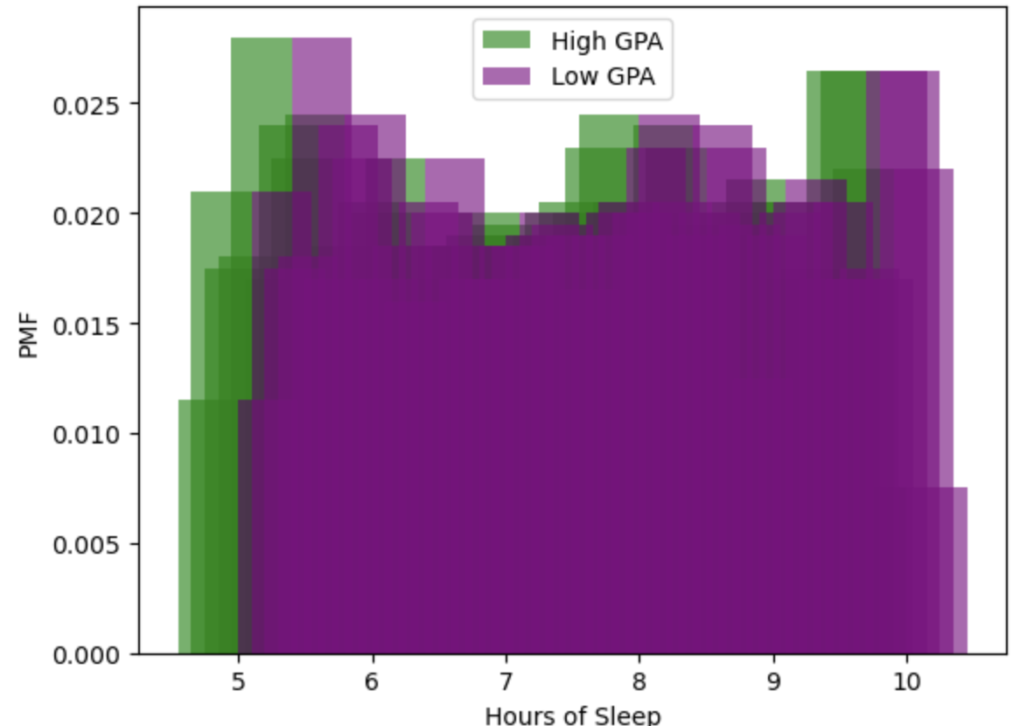
PMF: GPA and Hours of Sleep
This PMF looks at the difference between high GPA (3.0 or higher) and low GPA (less than 3.0) and hours of sleep.
On average students with a low GPA are predicted to get more sleep than students with a high GPA

Slide 11
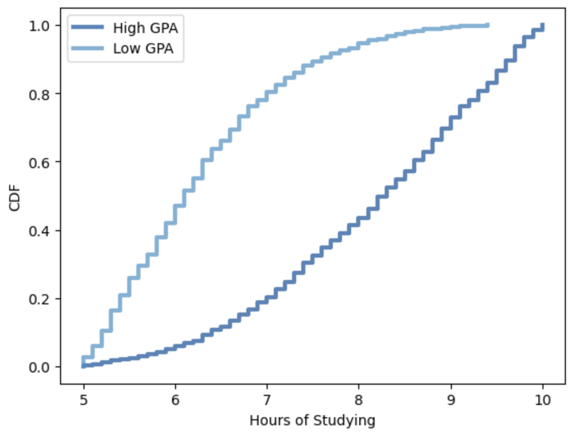
CDF: GPA and Hours of Studying
From this, we can see that a high percentage of students with a high GPA study more than 8 hours a day, on average
Students with low GPAs, on average, spend less time studying than students with high GPAs.
The students who study the most, on average, fall into the high GPA category. (10 hours per day).

Slide 12
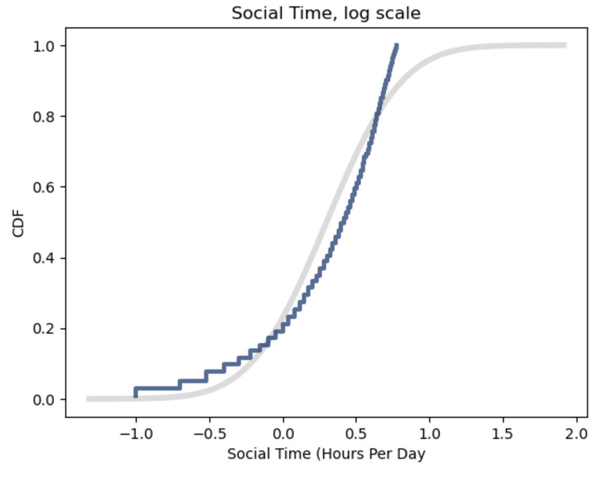
Lognormal Distribution of Study Hours
While the Lognormal model for this data is a better fit than the normal, it still is not a great fit.

Slide 13
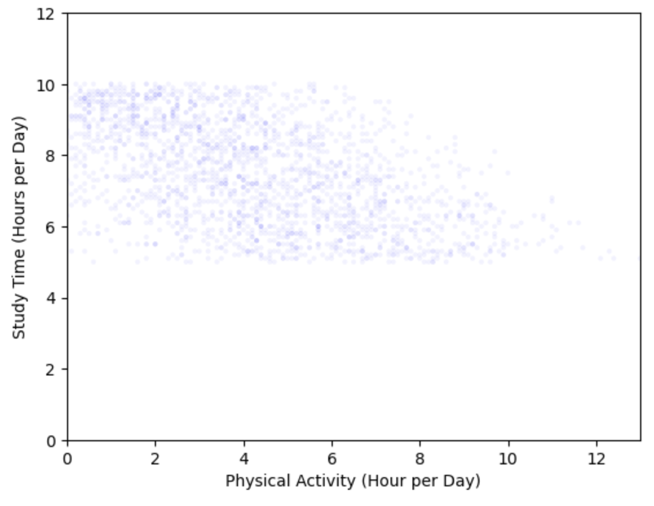
Scatter Plots Study Time vs Physical Activity
Covariance: -1.7465
Pearsons Correlation: -0.4881
From looking at the plot, there is a very small negative correlation between Physical Activity and Study Time.
The covariance value of -1.7465 suggests that there would be some kind of negative correlation.
A correlation coefficient of -0.4881 shows that there is a weak negative correlation between the variables.
These results would make sense because as one spends more time studying, there would be less time available for other activities such as exercising.

Slide 14
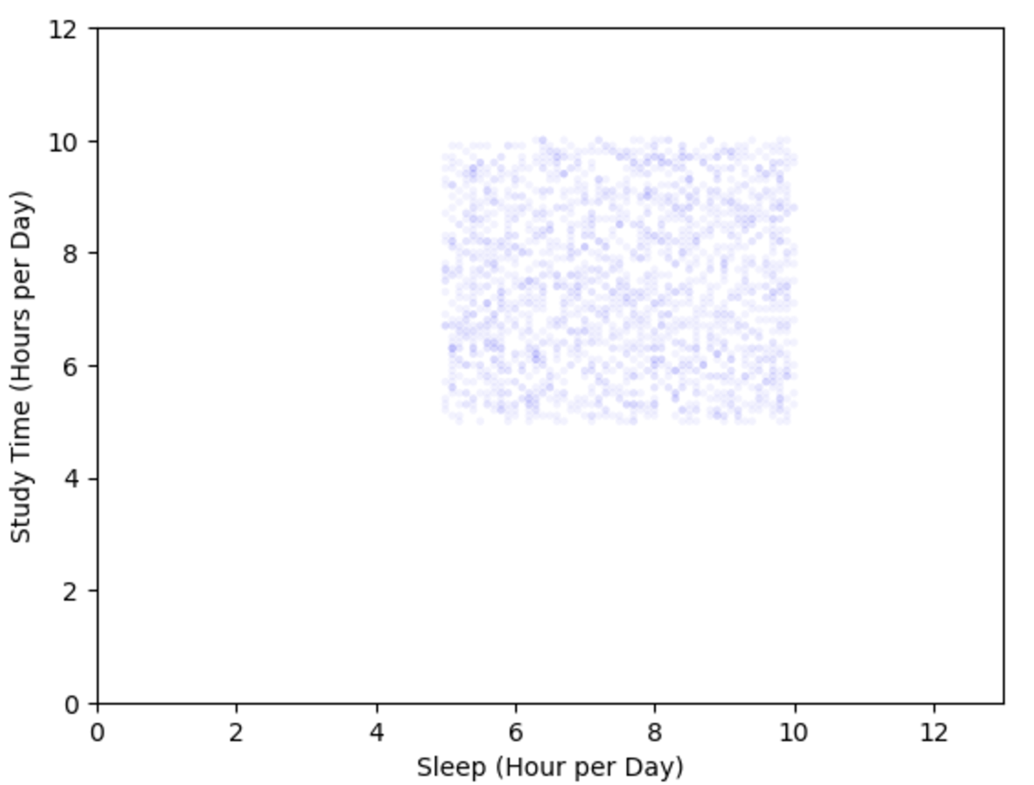
Covariance: 0.0556
Pearsons Correlation: 0.0267
Scatter Plots Sleep vs Study Time
From looking at the scatter plot, there is not obvious correlation between time spent studying and time spent sleeping each day.
The covariance value of 0.0556 and correlation coefficient of 0.0267 both support this.

Slide 15
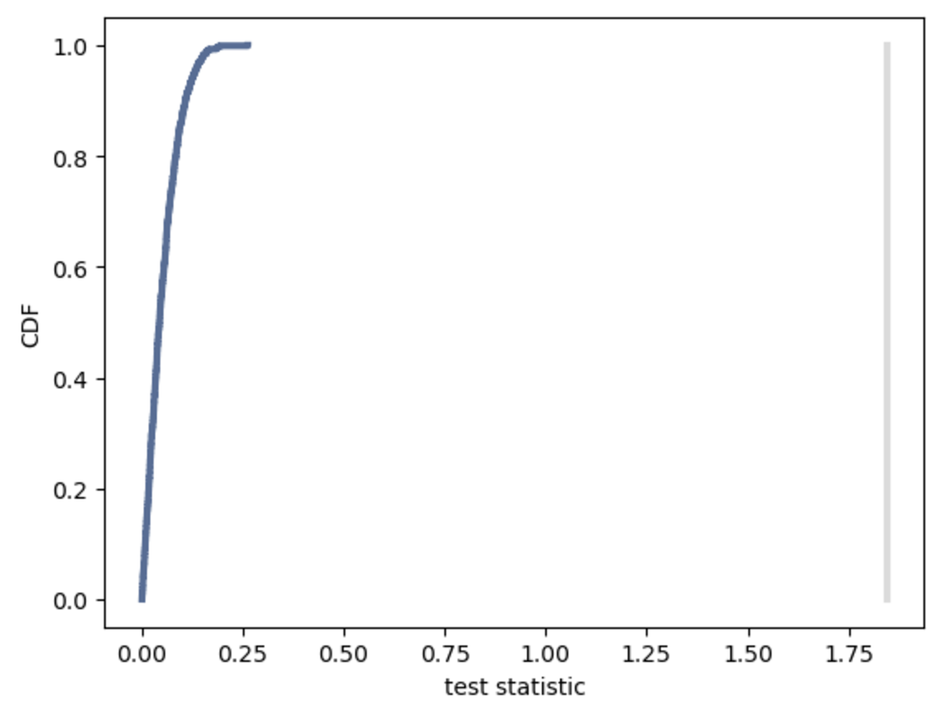
Hypothesis Test – Difference in Means
Both p-value tests had a value of 0. While the actual value is likely not 0, the value was likely so small that it rounded to zero.
This p-value shows that the results shown are not just from coincidence and the variables are almost always related.
We see a steep slope which indicates that most of the values are centered around a specific point. Given the small range of GPA scores, this makes sense.
There is also a high observed effect size which means that there is a practical significance to the findings.

Slide 16
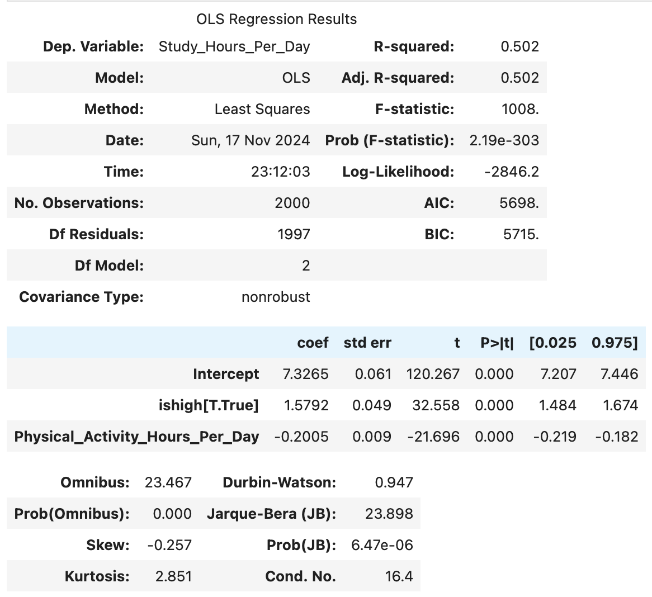
Regression Analysis
The coefficient of ‘ishigh’ is 1.5792 which means the affect these values have on birthweight is estimated to effect GPA by about 1.5792 points!
The p-values for these are 0 which means that this correlation is statistically significant
R squared for this model = 0.502 which is higher than R squared for Study Time and Physical Activity separately. This means that both variables together account for more of a variation in GPA.

